Slide 1
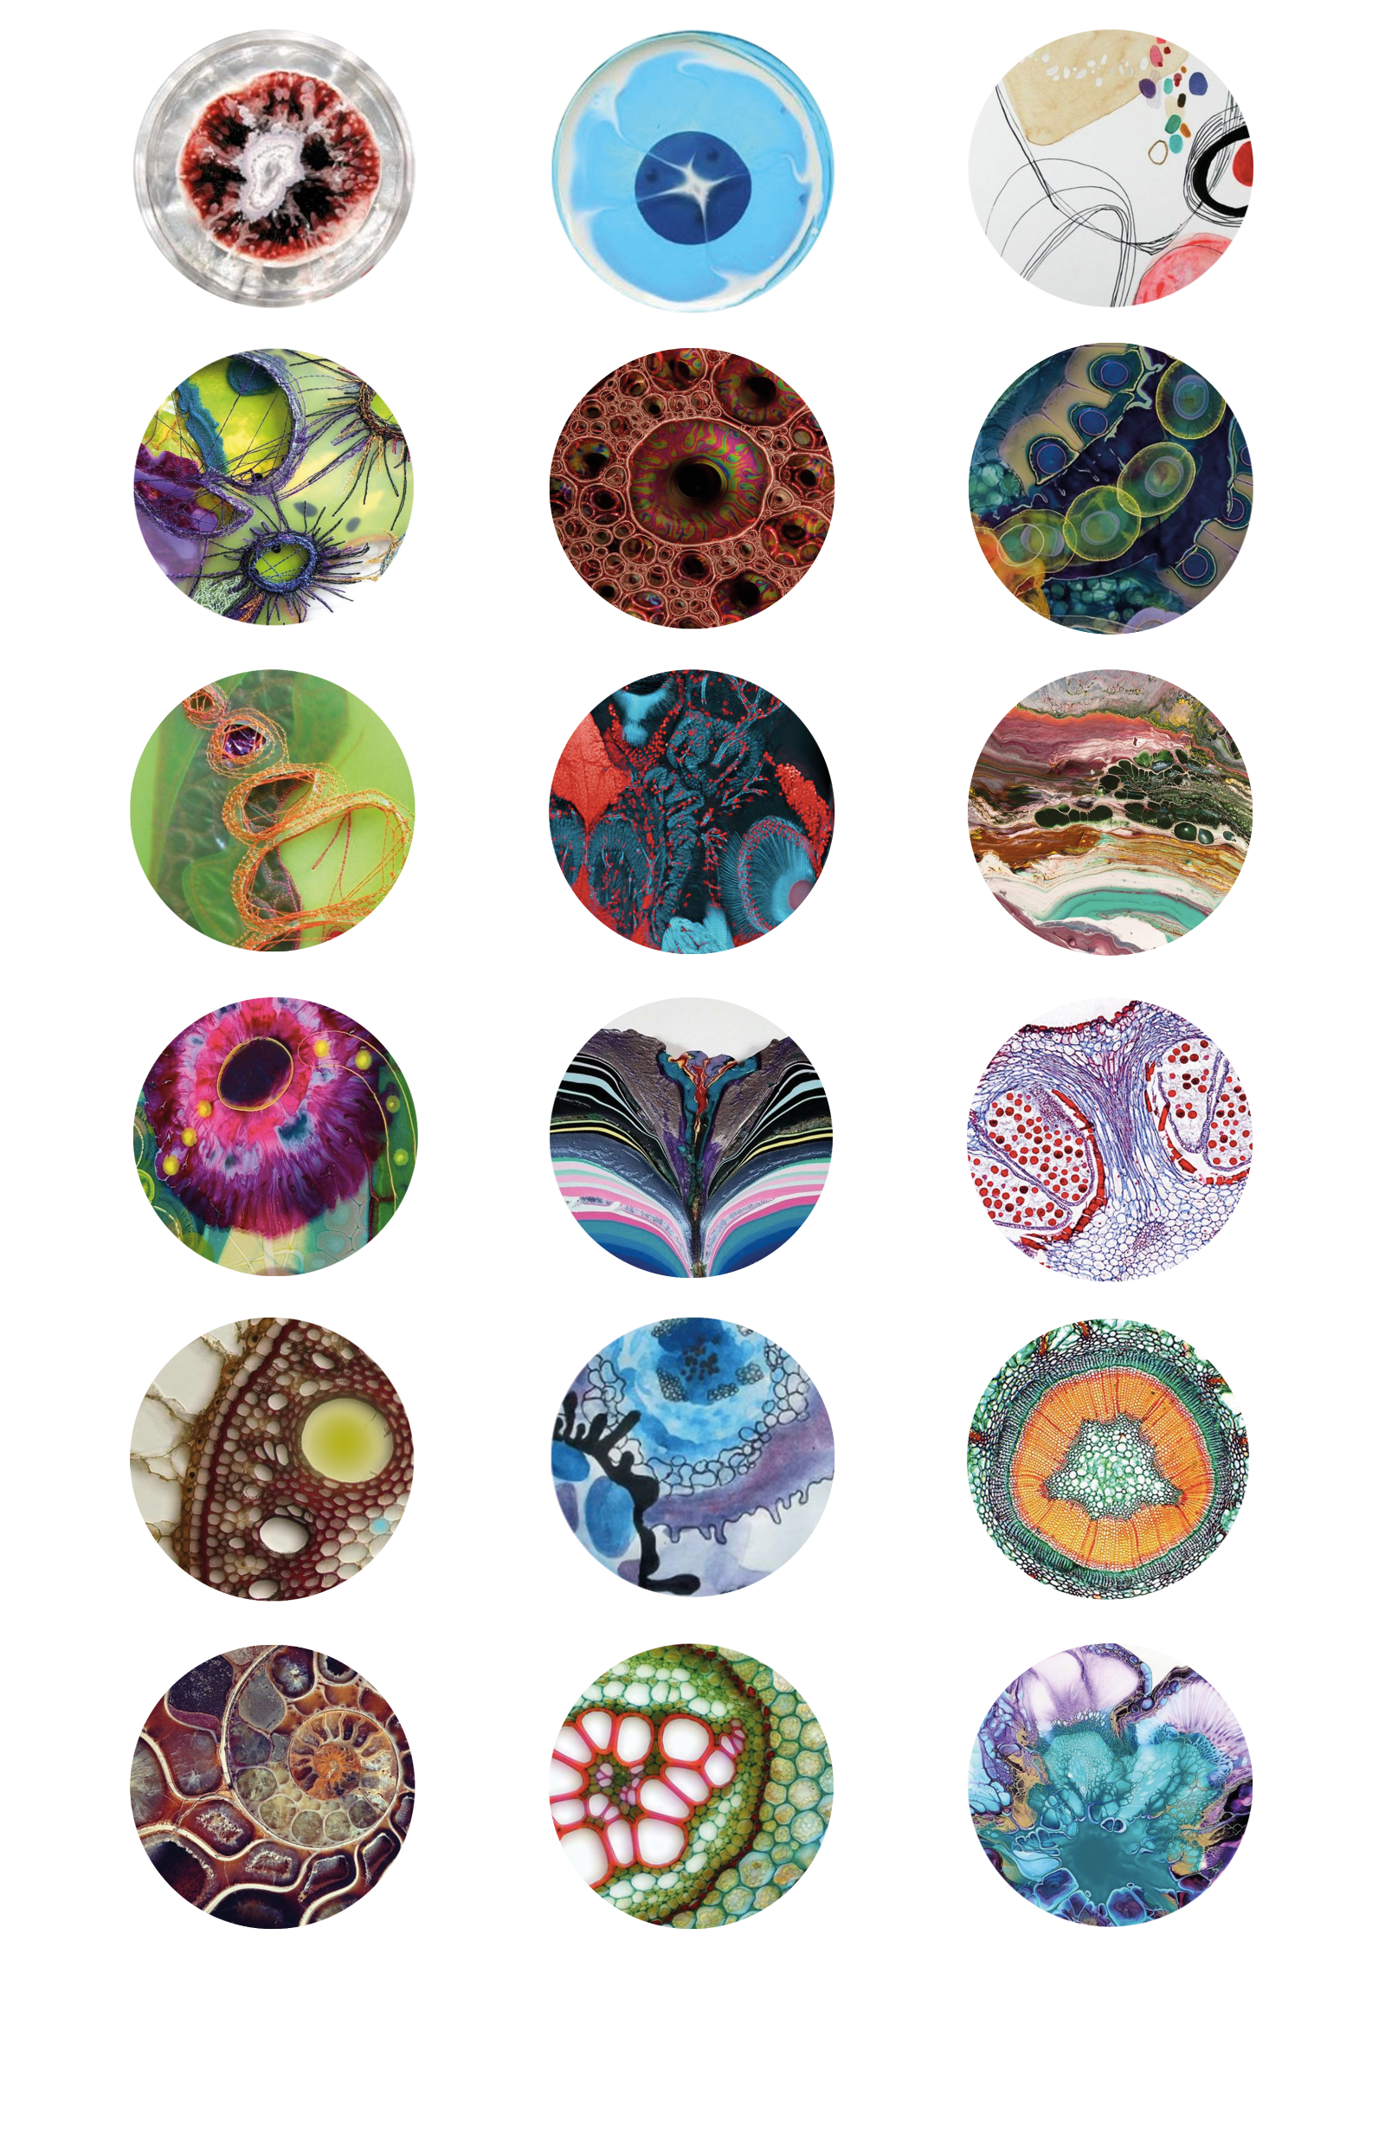
Welcome to the two-session reward learning experiment!

Slide 2
Welcome to the two-session reward learning experiment!
**Please first ensure that you are available to complete Session 2 in 7-8 days after this session!**
Today you can earn an extra bonus based on your performance up to an additional £6.00!
Half of today’s performance bonus will be paid after this session. The second half of the bonus will be paid after successful completion of Session 2 in 7-8 days.
Session 2 earns you a separate completion bonus of £3, → so your total bonus for the study can be up to £10.

Slide 3
Instructions
Please eliminate distractions in your environment while completing the tasks!
The reward task requires concentration in order to do well.
By focusing and learning the game, you can earn a higher bonus.
By doing well, you also help the experimenters by providing high quality data!
*As the task cannot be restarted, ensure you have enough time & computer battery to finish.
Thank you!

Slide 4
Instructions
Today is a multi-part study.
You need to complete different tasks.
Before you start, you will go through the instructions to prepare you for the main experiment.
You will have the opportunity to take breaks during this study.
Please do NOT click the forward/backward button or close the browser until the experiment is finished.
Please do NOT refresh the page during whole experiment.

Slide 5
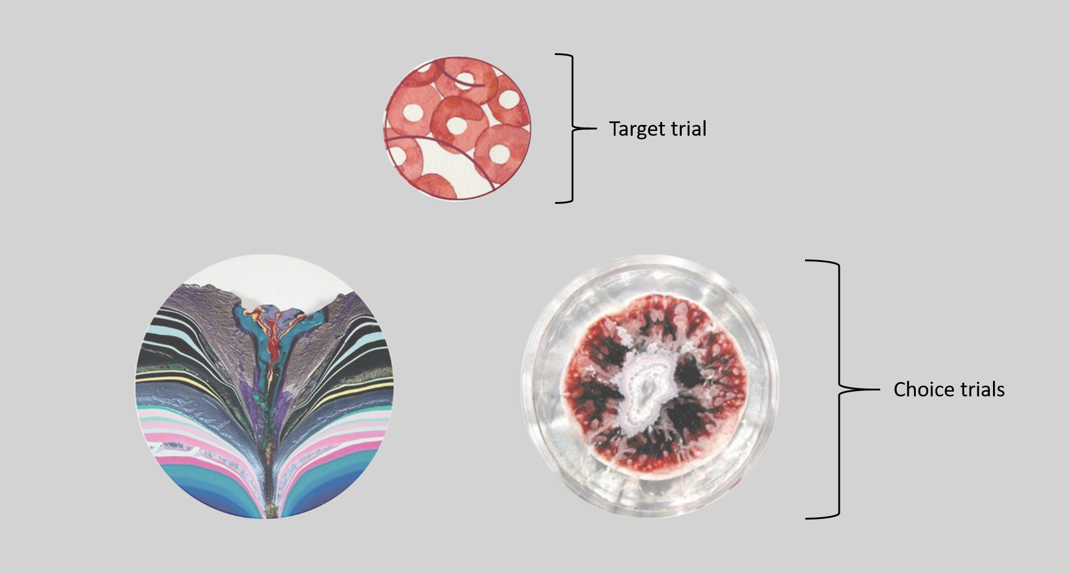
In the main part of the experiment, your goal is to learn over time which of two circle pictures is luckier.
When you choose the luckier picture, you will usually receive a 10 point bonus. When you choose the unlucky picture, you will usually receive 0 points.
At first you will just guess! Then through trial-and-error, you will learn which picture is luckier.

Slide 6
You will have a maximum of 3 seconds to make your choice for each trial.
Use the 'f' key to choose the LEFT picture.
Use the 'j' key to choose the RIGHT picture.
If you are too late, you will see a warning and get 0 points.
The pictures will randomly be shown on the left or right side. The location is not related to how lucky they are.

Slide 7
After your choice, the chosen picture will remain on the screen for 1 second before disappearing.
Then, after a variable delay, you will see feedback.
(The length of the delay to feedback differs on purpose.)
Lucky feedback:
Unlucky feedback:
+ 10 points!
0 points!

Slide 8
You will see a number of different pairs of circle pictures. Each pair will have one lucky and one unlucky picture.
It is important to note that the lucky picture will remain the same. The pictures will be shown *randomly* on the left or the right side of the screen – this is unrelated to luckiness.
Pairs will be repeated so that you can learn.
The more points you earn in the task, the more bonus you will be paid on top of your payment for your time – up to an additional £6.00! So please try your best!

Slide 9
For each pair of pictures, you will also see a “context” circle above.
This context circle does not relate to your choice, but it will *always* be shown with the same pair of pictures.
‘context’ circle

Slide 10
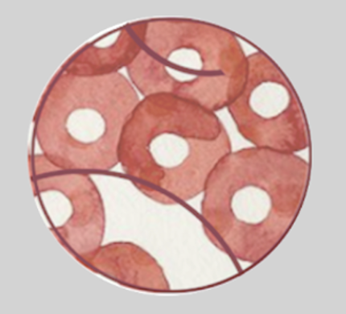
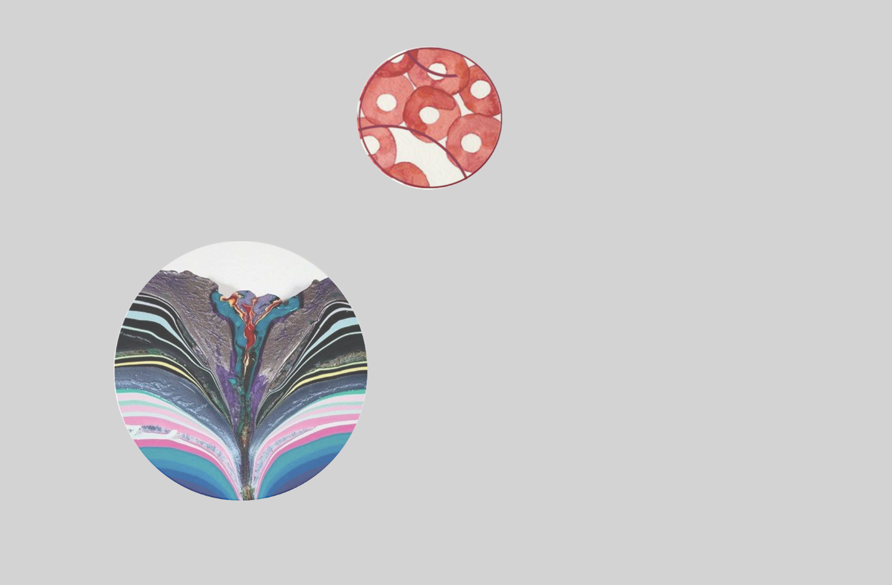
Overview of one ‘trial’
+ 10 points!
…delay…
Choose luckier picture with ‘f’ and ‘j’ keys
Chosen picture displayed
Variable duration!
Feedback displayed

Slide 11
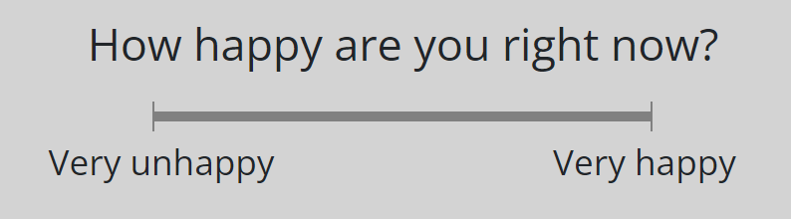
Mood Rating
Sometimes you will also rate your mood.
We collect happiness ratings because we are interested in changes in mood.
Note that the specific happiness ratings you provide have no influence at all on the rest of the experiment.
Just go with your initial feeling and click on the scale:
Please try to answer immediately. If needed, you have 20 seconds before a warning about losing points appears.

Slide 12
Before you start, you will go through a practice section to prepare you for the main experiment.
The practice section is starting soon.
You will respond by pressing the letters 'f' and 'j' only.
Now place your left index finger on the 'f' key and
your right index finger on the 'j' key.
Press 'f' or 'j' to continue

Slide 13
Before you start, there is a short practice section to get used to how the reward learning game works.
Please try your best!
If your performance during practice is too low,
it may lead to exclusion from session 2.
Remember, you choose by pressing the letters 'f' and 'j' only.
Please get ready to start: place your left index finger on the 'f' key and your right index finger on the 'j' key.
Press 'f' or 'j' to start!

Slide 14
Thank you!
You have completed the practice part of the experiment.
Please be ready for the main part of the experiment.

Slide 15
The main part is starting.
Remember, respond by pressing the letters 'f' and 'j' only.
Now place your left index finger on the 'f' key and
your right index finger on the 'j' key.
Press 'f' or 'j' to continue

Slide 16
Great work!
You have completed the main part of the experiment.

Slide 17
This is the end of today’s session!
Thank you for taking part! ☺
You can return to PROLIFIC by clicking below.

Slide 18
This is the end of today’s session!
Thank you for taking part! ☺
Please look out for the invitation
to session 2 in 7 days!
For that 30-minute session, you will receive a £3 completion bonus, plus the second half of your earnings (£) from today!
You can return to PROLIFIC by clicking below.

Slide 19
Next, there are a 3 short parts that test what you learned in the main first part
The first test is similar to the first part.
You will see two pictures, and your goal is to choose the one that you think is luckier (more likely to win points).
Use your knowledge from the previous part.
Press either ‘f’ or ‘j’ key to make a choice.

Slide 20
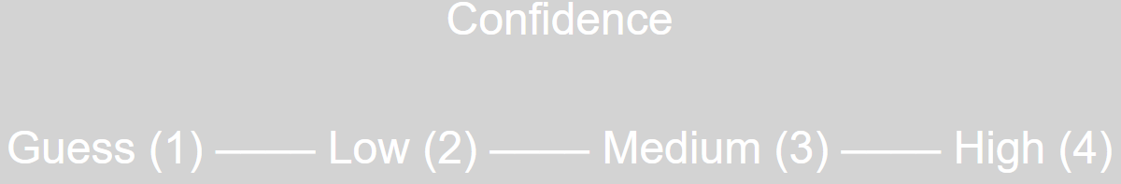
Choice questions
Following your selection, you will enter a confidence rating reflecting whether you think your choice was accurate:
Enter your response using the keys 1, 2, 3, or 4
Guessing is OK!

Slide 21
Choice questions
Your choices will still win you points!
However, you will not get feedback about the result on the screen.
Instead, the computer will record how many points you earn. These points will be added toward your bonus payment.
Please do your best to focus and make good choices, so that you can increase your bonus!

Slide 22
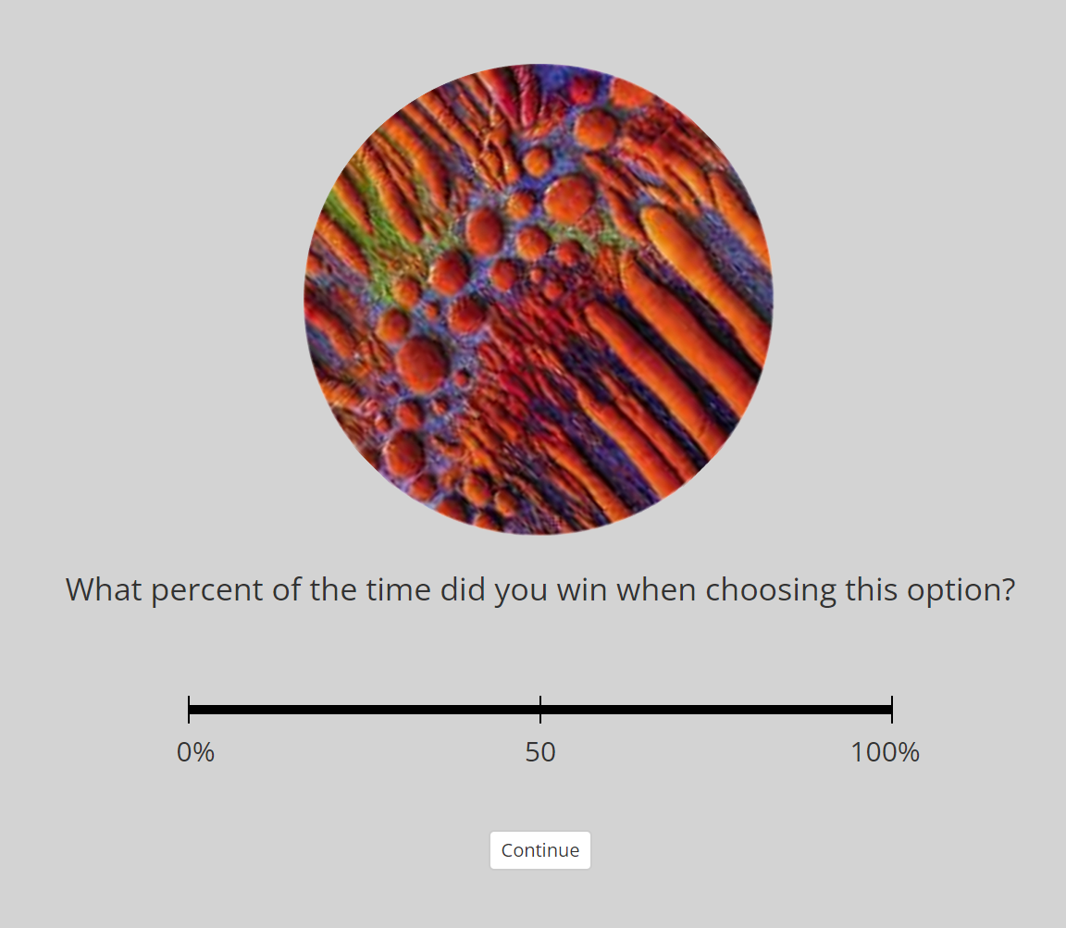
Win rating questions
Next, you will rate each picture according to how lucky it was - the “probability” of winning.
A picture that always won would correspond to an answer of ‘100%’
One that never won points would correspond to an answer of ‘0%’.
(Never)
(Always)

Slide 23
Win rating questions
Go with your best guess or ‘gut feeling’ to make the rating.
Use the mouse to indicate the likelihood of winning with each picture (the response is similar to the happiness ratings question).
(Never)
(Always)

Slide 24
Time estimating questions
In the last test part, you will be asked questions about how long of a delay was between your choice and the feedback during learning.
You will see a pair of images from the previous part.
Your goal is to try to remember whether the delay (from the moment you made your choice selection until the feedback appeared) was *long* or *short*.
Overview of earlier learning trial:
How long?
+ 10 points!
or 0 points
…delay…
Choice made
Feedback displayed

Slide 25
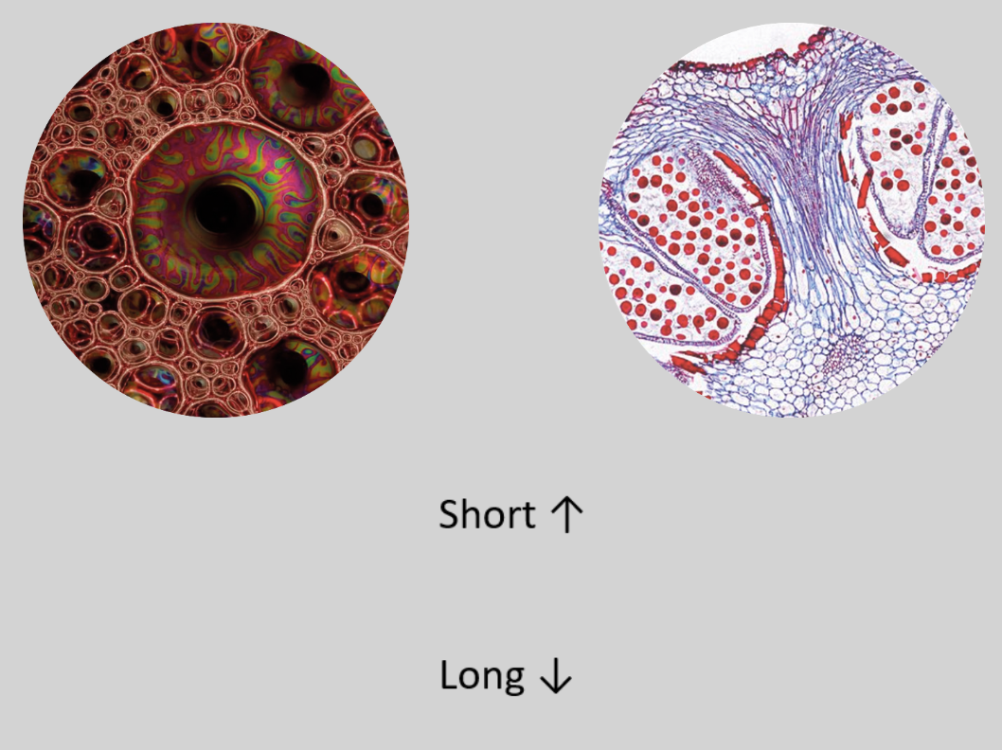
Time estimating questions
You will see pairs of circle pictures that were always together.
Short indicates that feedback appeared briefly after choice.
Long represents a long delay between your choice and feedback.
Half of the pairs were long, and half were short.
Press either ‘up arrow key’ or ‘down arrow’ key to make a choice.
Please provide your best estimate! Guessing is OK!
How long was the delay between this choice and feedback onset?

Slide 26
Delay rating questions
In the last test part, you will be asked questions about how long of a delay was between your choice and the feedback during learning.
You will see a pair of images from the previous part.
Your goal is to estimate the duration in seconds from the moment you made your choice selection until the feedback appeared.
Overview of earlier learning trial:
How long?
+ 10 points!
or 0 points
…delay…
Choice made
Feedback displayed

Slide 27
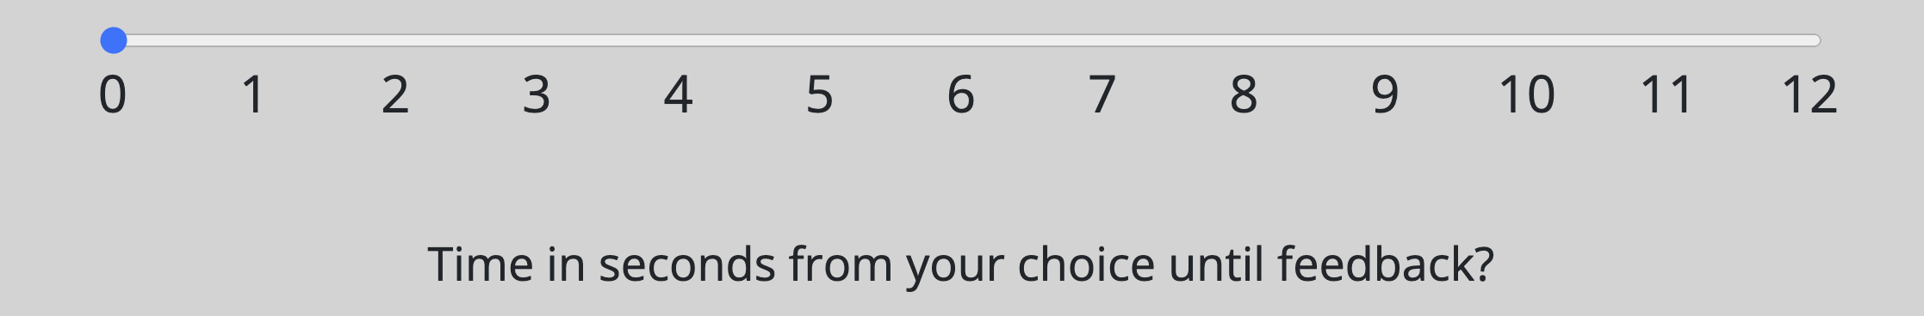
Delay rating questions
You will see pairs of circle pictures that were always together.
A rating of 0 sec indicates that feedback appeared immediately after choice.
A rating of 12 sec represents the highest time delay, indicating a very long delay between your choice and feedback.
To get a better feel for the this range of time, right now, try counting from 1-12 seconds (silently or out loud).
Counting by saying “one-one thousand, two-one thousand…” is one good way to do it more accurately
Please provide your best estimate! Guessing is OK!

Slide 28
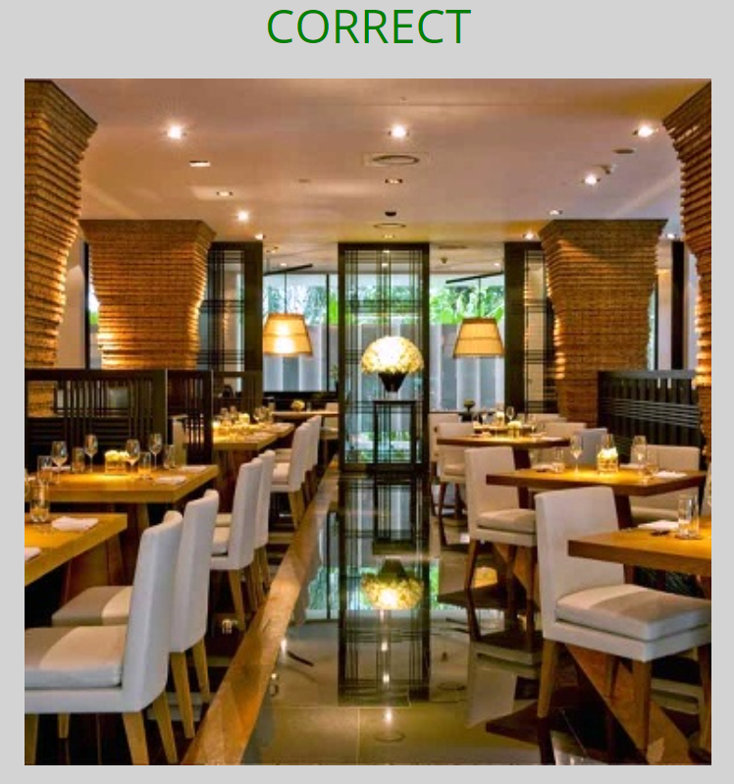
Review
+ 10 points!
+ 10 points!
Delay
Choose luckier picture with ‘f’ and ‘j’ keys
Chosen picture displayed
Variable duration
Feedback displayed

Slide 29
Welcome to session 2 of the reward learning experiment!

Slide 30
Welcome to session 2 of the reward learning experiment!
After today’s session, you will receive a completion bonus of £3, plus the second half of your reward bonus from the first day, plus up to £1 bonus today.
We greatly appreciate your continued participation!
The session today is shorter than the first session (usually taking 18 to 26 minutes).
First there are two short memory sections.
Finally, there is a task that asks you to keep letters in mind.

Slide 31
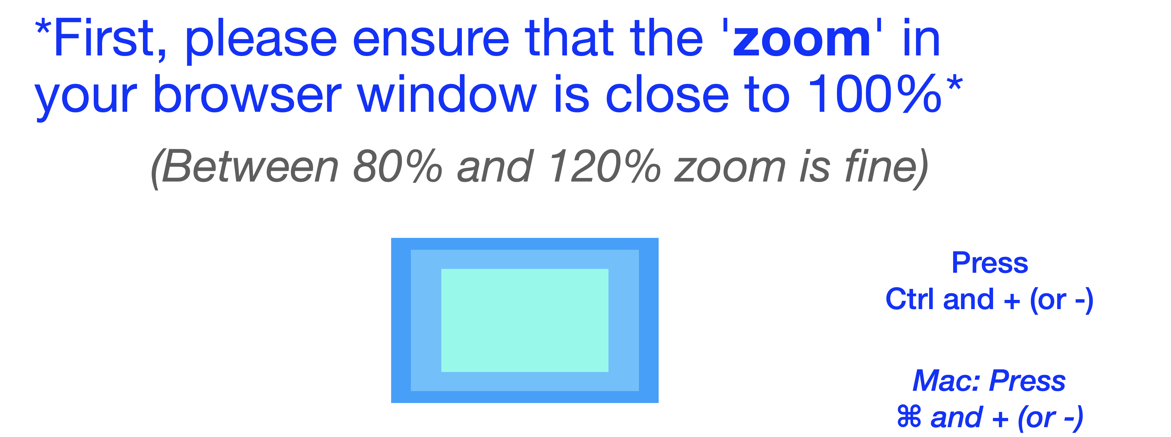
Please exit 'full screen' to fix this. Thank you!
If the zoom is a lot more than 100%, the questions will spill over into the next page!
If zoom is less than 60%, the task will also be made difficult to complete.

Slide 32
Win rating questions (Part 1 of 2)
First, you will rate pictures according to how lucky you remember they were in session 1. This part works the same as in that session.
A picture that always won would correspond to an answer of ‘100%’
One that never won points would correspond to an answer of ‘0%’
(Never)
(Always)

Slide 33
Win rating questions (Part 1 of 2)
Go with your best guess or ‘gut feeling’ to make the rating.
Use the mouse to indicate the likelihood of winning with each picture.
(Never)
(Always)

Slide 34

Win rating questions (Part 1 of 2)
The first question is a practice question!
You will see this image. Please click near where '75' would be on the scale, representing winning 3 out of 4 times (75%):
(Never)
(Always)

Slide 35
Choice questions (Part 2 of 2)
The final test asks you to try to remember and choose the luckier of two pictures from session 1. This part works the same as in that session.
You will see two pictures, and your goal is to choose the one that you think is luckier (more likely to win points).
Use your knowledge from the first session. Guessing is ok!
Press the 'f' or 'j' key to make a choice.
f
j

Slide 36
Choice questions (Part 2 of 2)
Following your selection, you will enter a confidence rating reflecting whether you think your choice was accurate:
Enter your response using the keys 1, 2, 3, or 4
Guessing is OK!

Slide 37

Choice questions (Part 2 of 2)
Your choices will still win you points!
However, you will not get feedback about the result on the screen.
Instead, the computer will record how many points you earn. These points will be added toward your bonus payment.
Please do your best to focus and make good choices, so that you can increase your bonus!
You start with a practice choice, where there is text on the pictures indicating which one to choose. (Remember, press f or j to choose!)
f
j

Slide 38
Thank you!
You have completed the main part of the experiment.
Now, it's time for a 2-minute break. Feel free to exit full-screen mode and take some rest.

Slide 39
You have reached the last part!
The following task consists of two parts. First, you will see sentences on the screen, which you are supposed to read out loud. These sentences can make sense (e.g., "More and more women want to have a career.") or not (e.g., "I stopped by the gas station to refuel on apple juice."). Your first task is to judge the content of each sentence. You will do this by clicking a button to indicate whether it makes sense or not (yes or no button). After this decision, you will see a letter on the screen, which you are also supposed to read out loud. Your second task is to memorize this letter in order to recall it later on.
After two to six sentences (which you are supposed to judge) and letters (which you are supposed to memorize), you will see a page with six empty fields. Whenever this happens, please enter all the letters you still remember since the last round of empty fields. Often it's easier to recall the letters in the order in which they were presented, but this isn't really necessary. Please use only one field per letter. After you entered all the letters you still remember, you can start the next round by clicking the "Continue" button.

Slide 40
Welcome to the reward learning experiment!
Welcome, and thank you for completing the earlier survey session. By returning today and completing the session, you will receive a completion bonus of £3, plus your reward bonus from today.
A follow-up third session invitation may come in 1 week from today. Completing that session will also lead to a bonus.

Slide 41
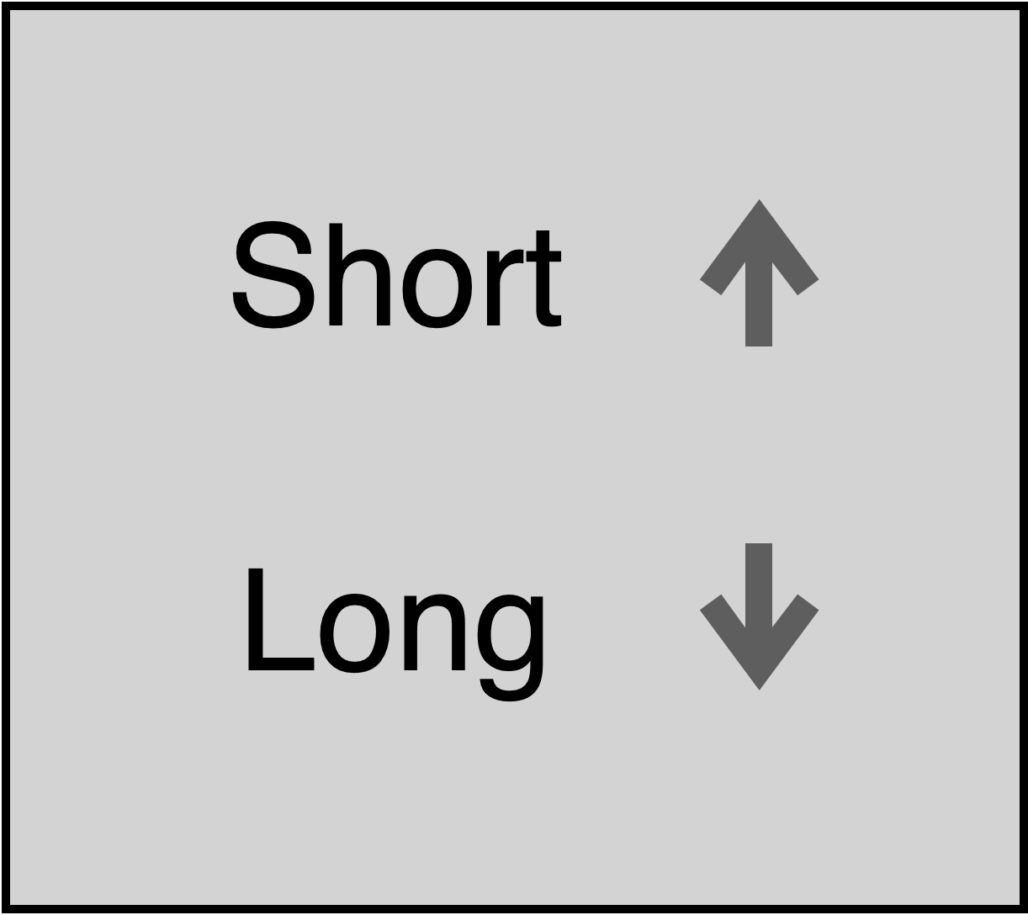
Reward bonus
Today in the main part you will play a game where you will earn an extra bonus based on your performance, up to an additional £6.00!
The performance bonus will be paid only after successful completion of Session 2 in 2 days.

